Slide 1

ALEXANDER SOUZA
APPLIED PROJECT AND MINOR DISSERTATION
Alexander Souza – G00317835
Supervisor
Damien Costello
Application deployed on AWS and Heroku:
http://54.210.4.37/mycareer/
GitHub
https://github.com/alexpt2000gmit/4Year_MainProject_MyCareer
YouTube video:
https://youtu.be/6NChE0NcoLw

Slide 2

THE PROJECT
Applicant Tracking System

Slide 3
The Application
MyCareer is a system that fully supports the recruitment and selection process of HR, provides an internal system to manage resumes, jobs, and a tool that can be integrated with the current system of the company that will make the company's own website in an online recruiter of candidates.
MyCareer is an application that, in addition to being scalable, uses the best in development, appearance, security and robustness frameworks.

Slide 4
The Application
Features
Applicants
View available jobs.
Apply for the selected work through the website.
Submit the email to the job alert receipt

Slide 5
The Application
Features
Administrator
Manage all available jobs.
View all applicants.
View applicants per job.
The process of evaluation of the candidate in the act of the interview.
Assessment with technical questions for candidates, divided by topics.
Manage schedule for interviews and other appointments.

Slide 6
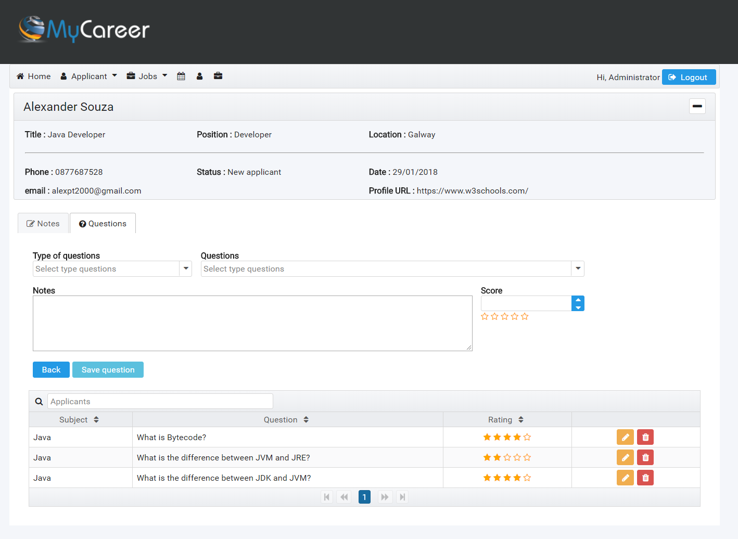
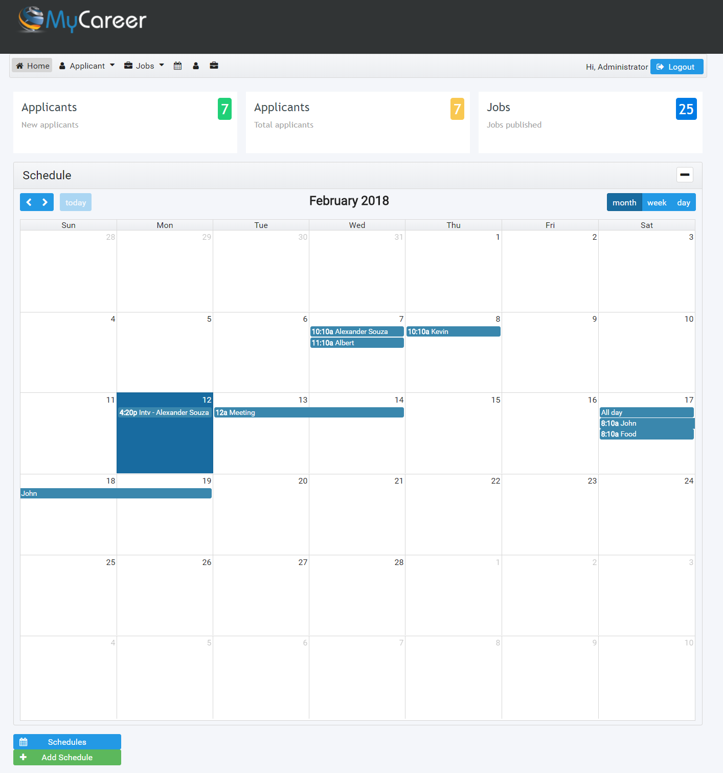
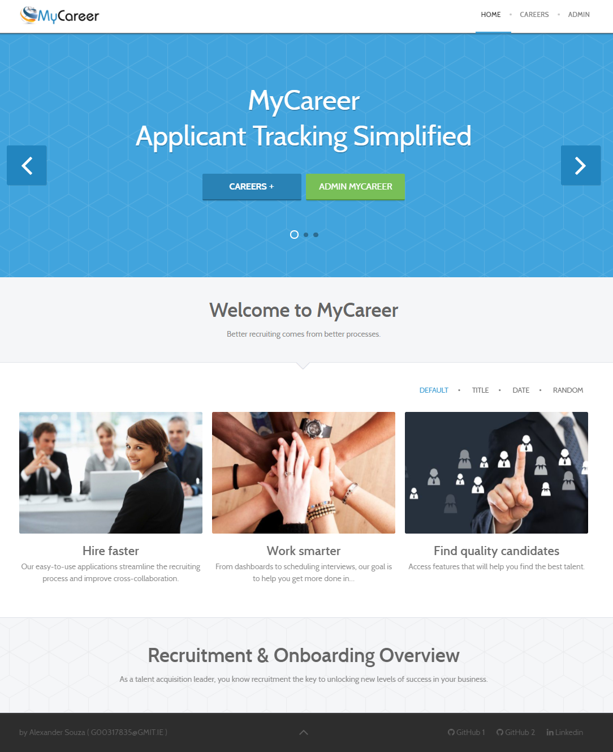
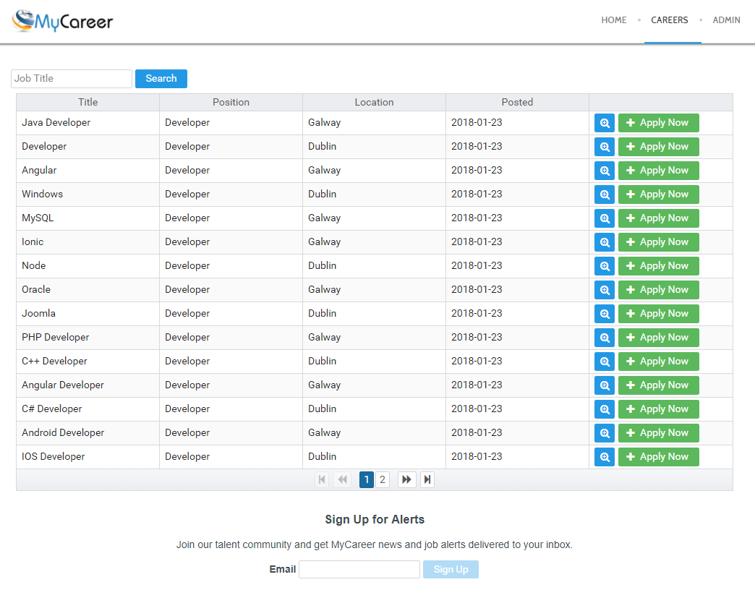
For this project I will use various technologies, techniques and tools, such as:
IDE - Development environment
Spring Tool Suite / Visual Studio Code
API - Back end
Spring Security
JSON Web Token (JWT)
Spring Boot
Maven
Hibernate
Flyway
Swagger UI
Database Environment
MySQL
Front end
Joomla
HTML5 and CSS
Angular 4
PrimeNG - is a collection of rich UI components.
Cloud services
AWS
Heroku
Technologies
The best team is where
the best leader be

Slide 7

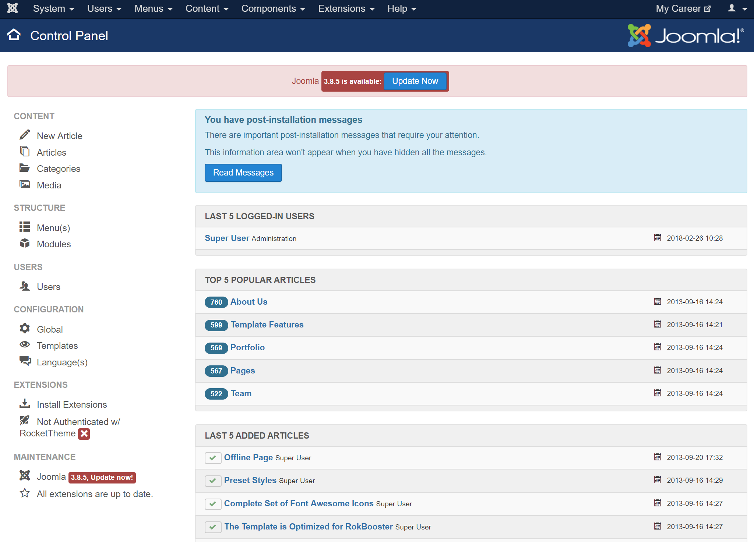
Website
Joomla
The system also demonstrates how the system can also be used on the company's current website, in which case it has been used by CMS Joomla, a powerful website development tool that allows users to manage website content from a backend.
Access URL for the Website page:
http://54.210.4.37/mycareer/
The best team is where
the best leader be

Slide 8
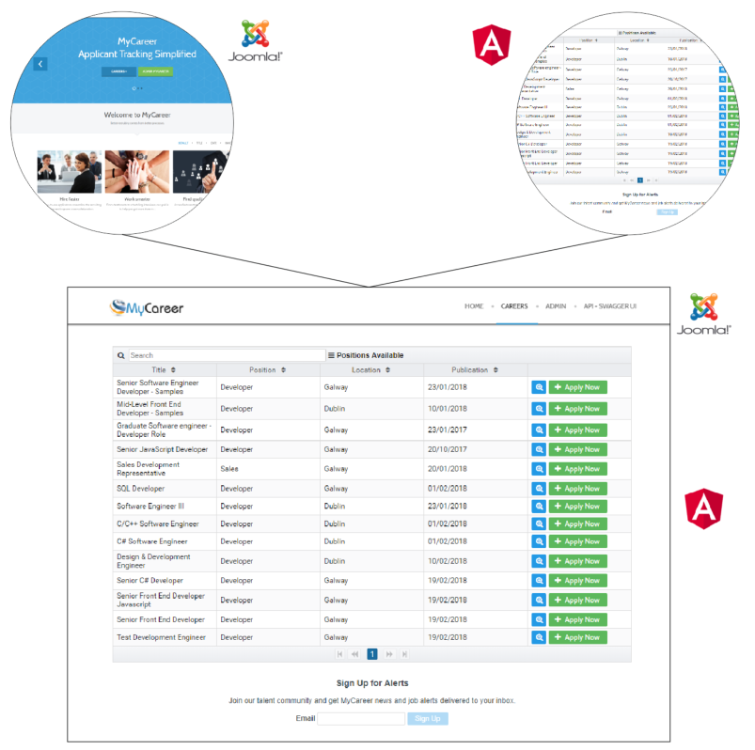
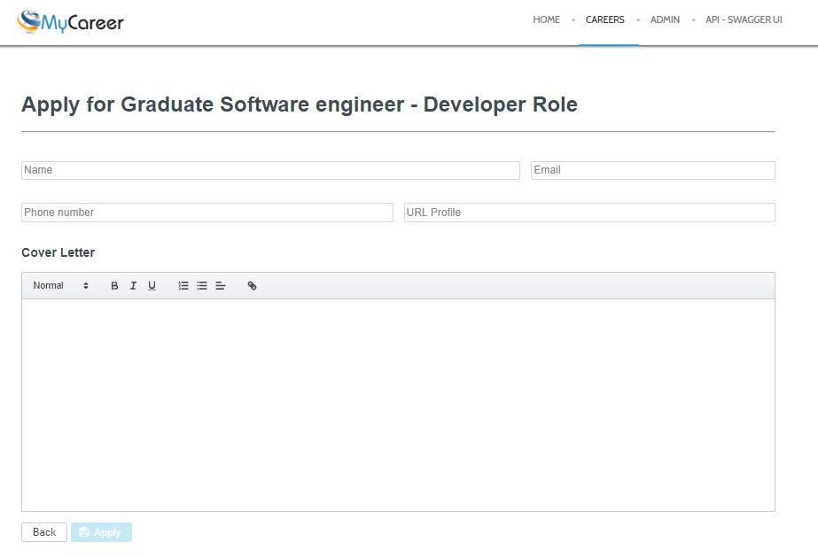
The front-end (Applicants)
Joomla and Angular
Through the job application module, the applicant can view a list of all available jobs on the page and also be able to submit their personal data to the selected position.
Access URL for the front-end Applicants page:
https://mycareer-webajobs.herokuapp.com/
The best team is where
the best leader be

Slide 9
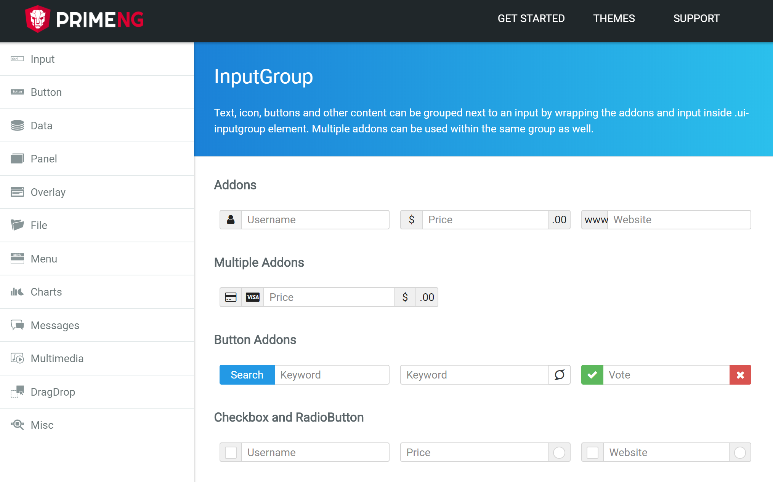
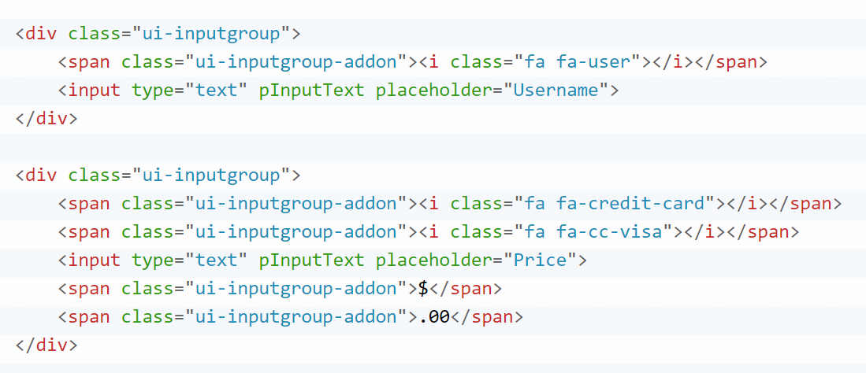
PrimeNG
UI components.
The best team is where
the best leader be

Slide 10
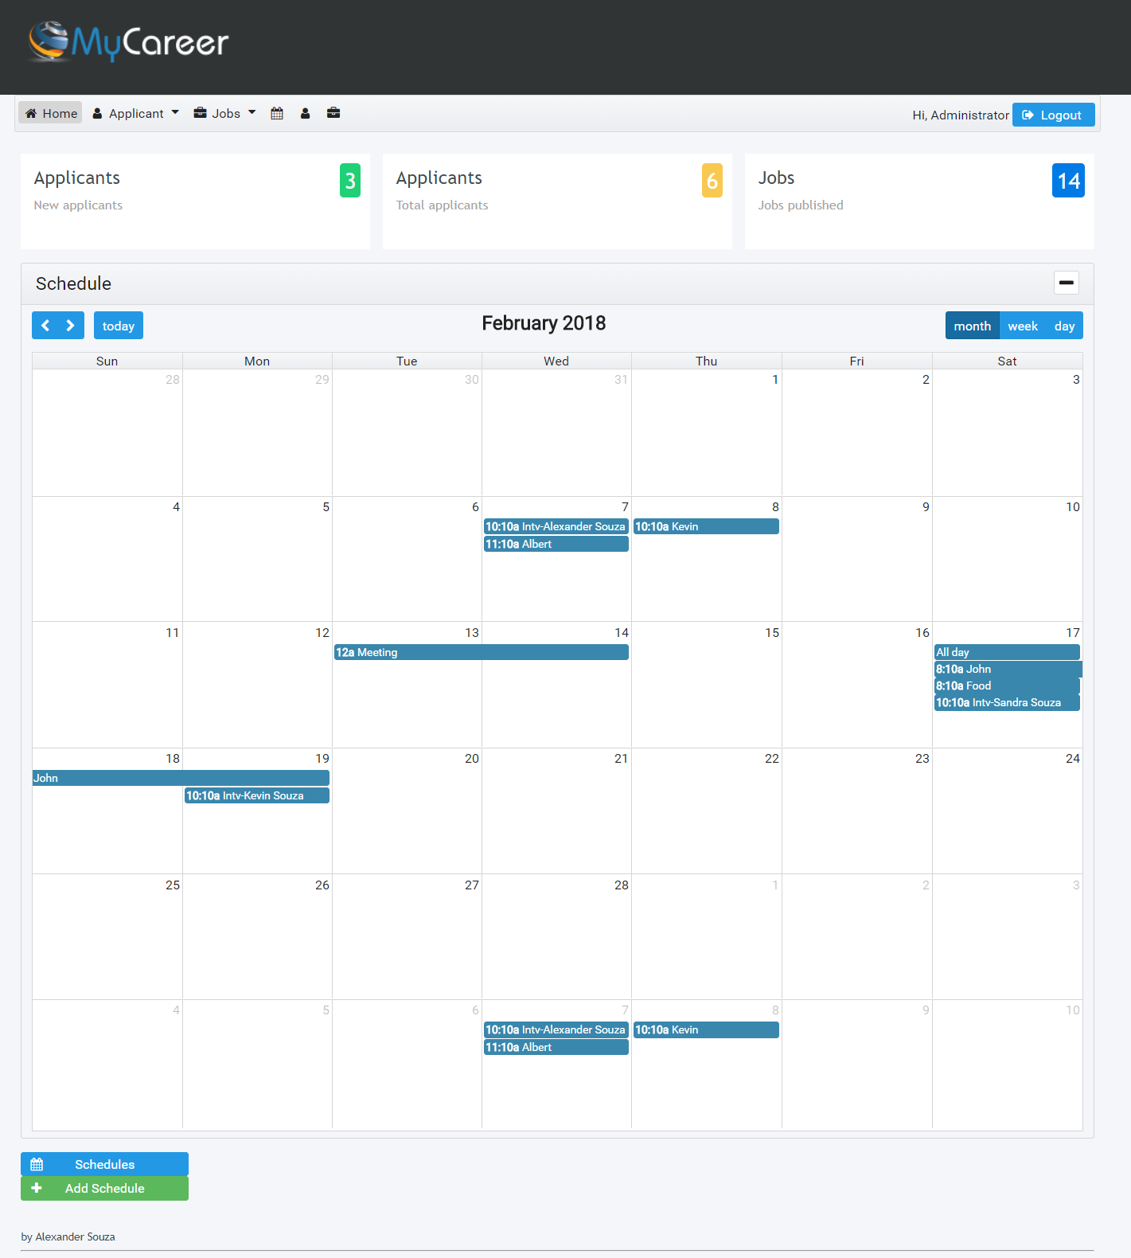
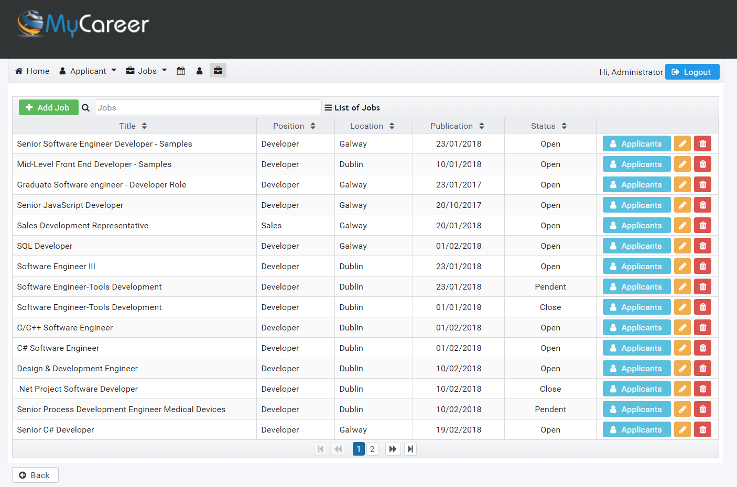
Backend (Admin - Applicants)
Angular
Through this module, the administrator can manage the data provided by the API, such as:
Manage published work;
Manage applicants;
Manage the system agenda;
Candidate evaluation system;
List of questions for the interview process.
MyCareer Admin
https://mycareer-webadmin.herokuapp.com/
The best team is where
the best leader be

Slide 11
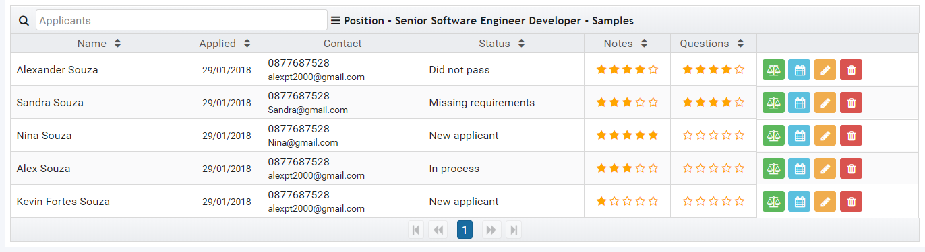
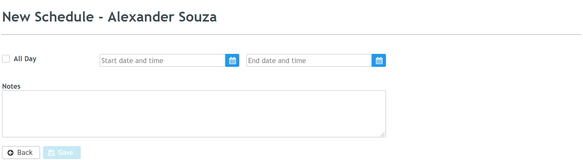
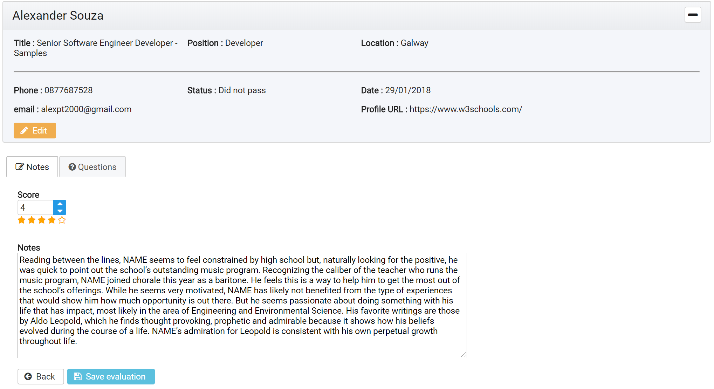
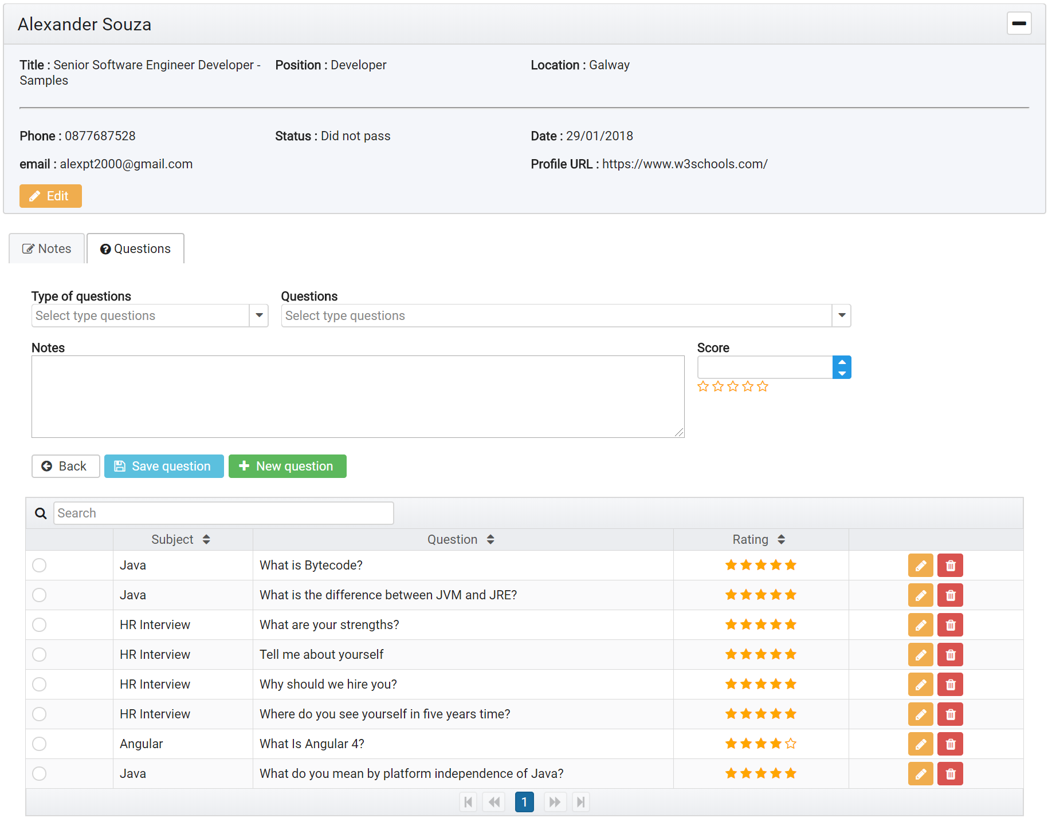
Backend (Admin - Applicants)
Angular
The best team is where
the best leader be

Slide 12















The Application
ARCHITECTURE / TECHNOLOGIES
Back end
Front end
RESTful API
cms
Authentication Server - JSON Web Tokens
The best team is where
the best leader be
Authentication Request
Access Token
Career application module will be embedded on website
Request for
Protect Resource
(Access Token)
Protected
Resource
System Data

Slide 13
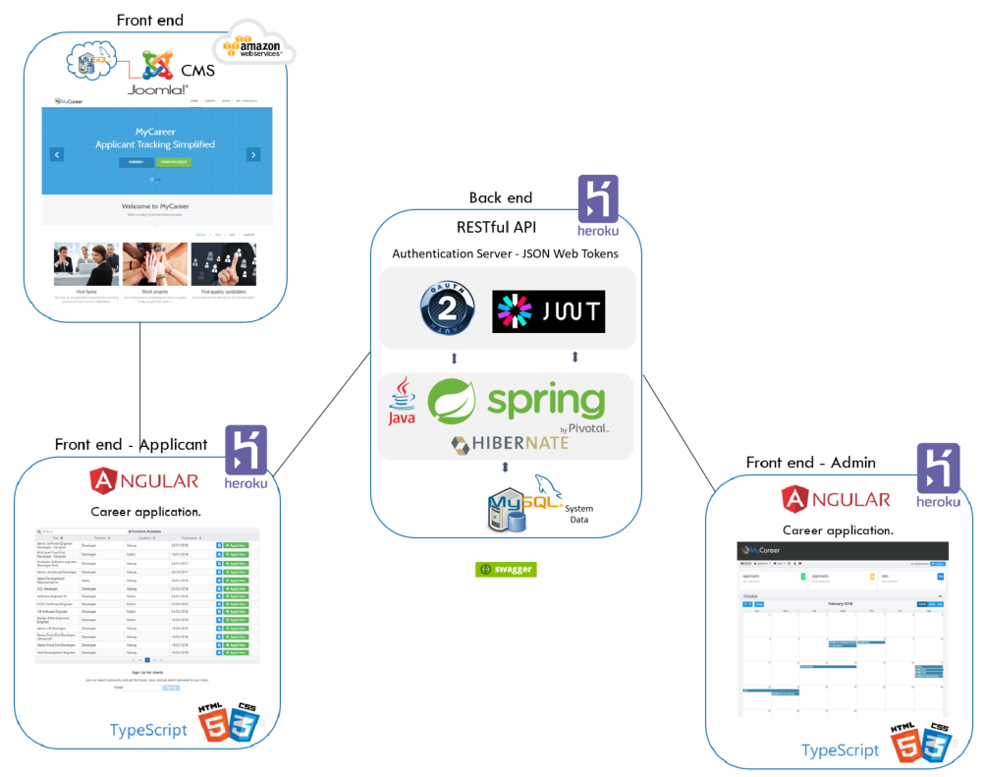
Website
http://54.210.4.37/mycareer/
MyCareer Jobs
https://mycareer-webjobs.herokuapp.com/
MyCareer Admin
https://mycareer-webadmin.herokuapp.com/
API – Swagger UI
https://mycareer-api.herokuapp.com/swagger-ui.html
Website
http://54.210.4.37/mycareer/
API – Swagger UI
https://mycareer-api.herokuapp.com/swagger-ui.html
MyCareer Jobs
https://mycareer-webjobs.herokuapp.com/
MyCareer Admin
https://mycareer-webadmin.herokuapp.com/

Slide 14
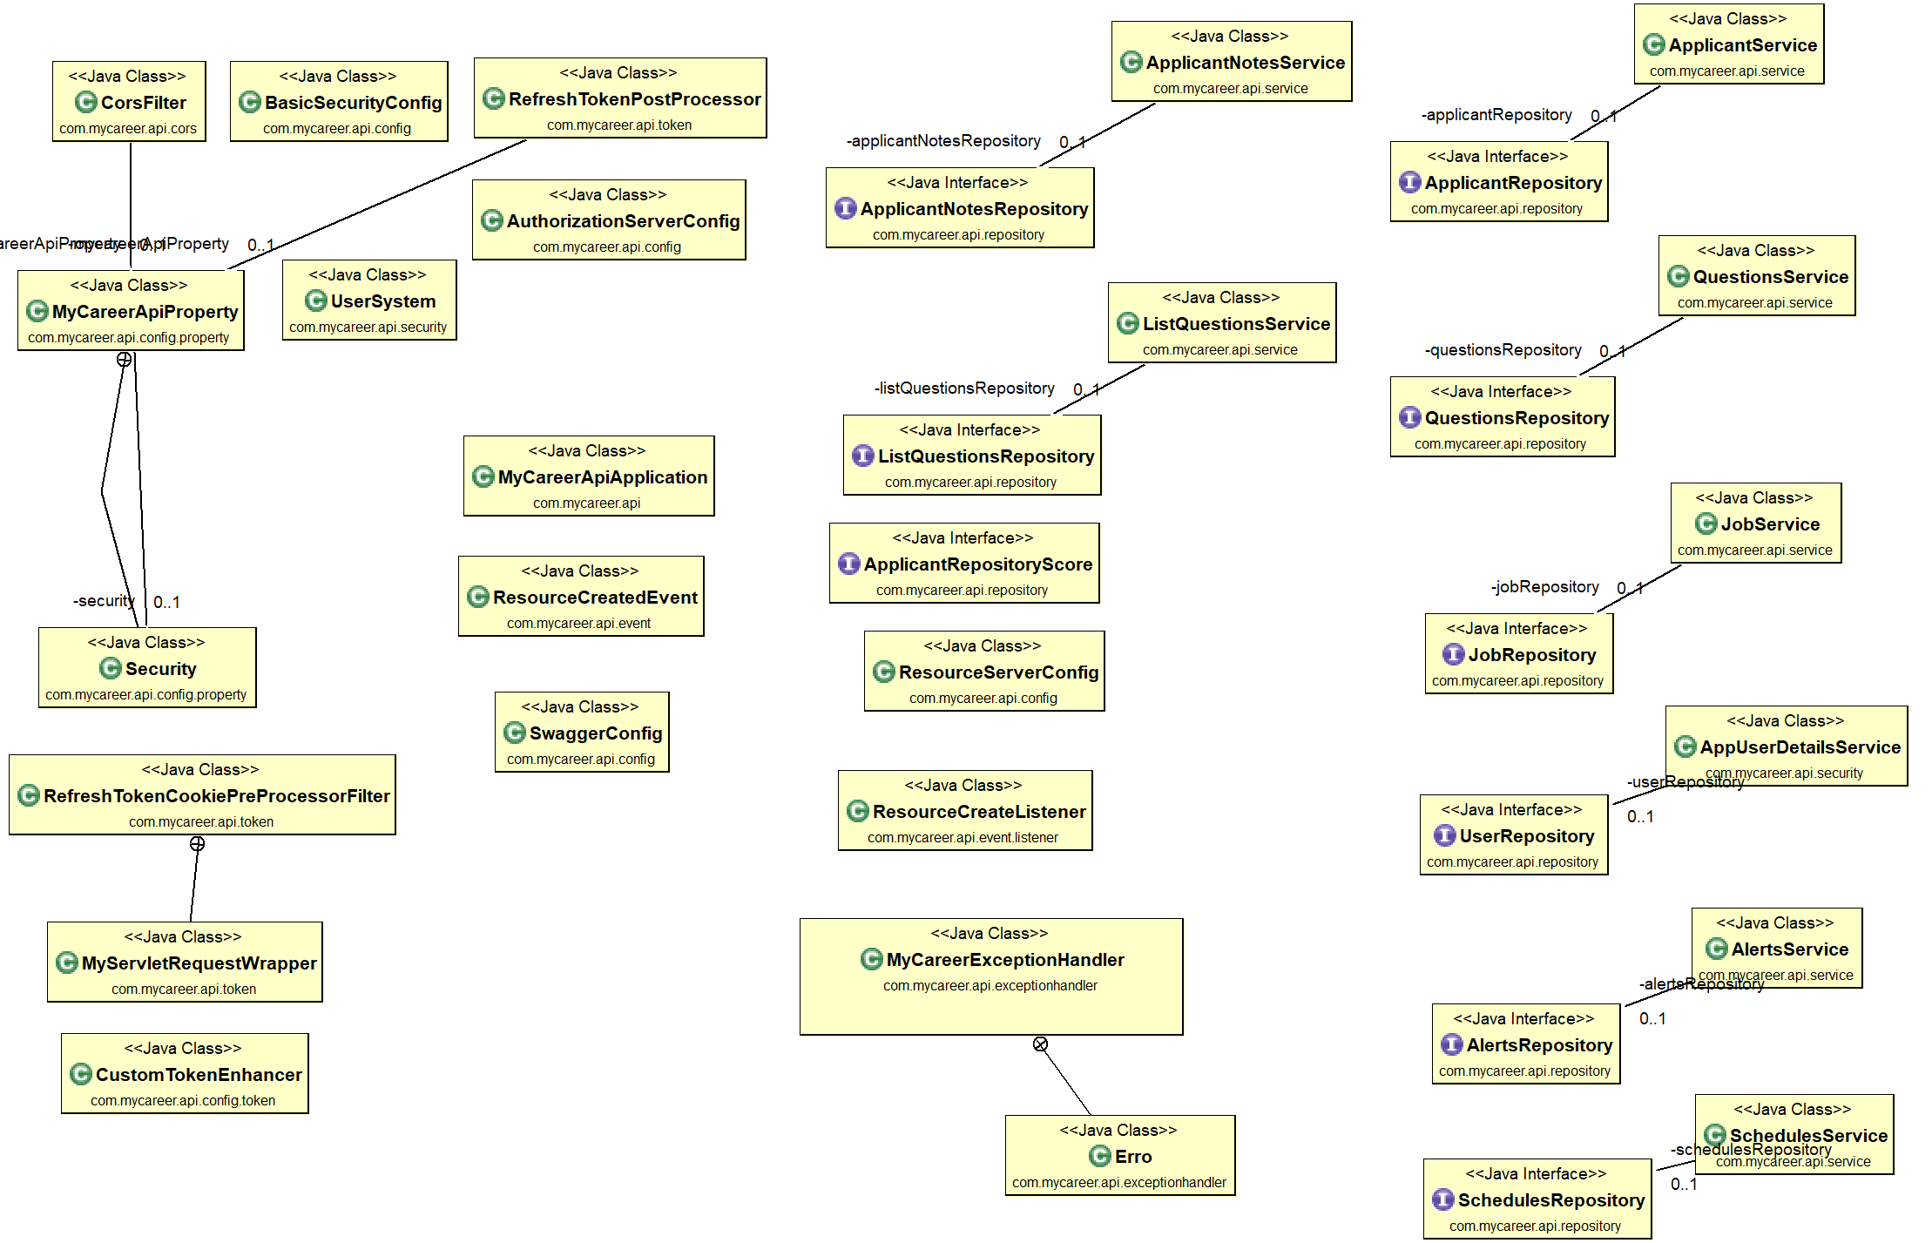
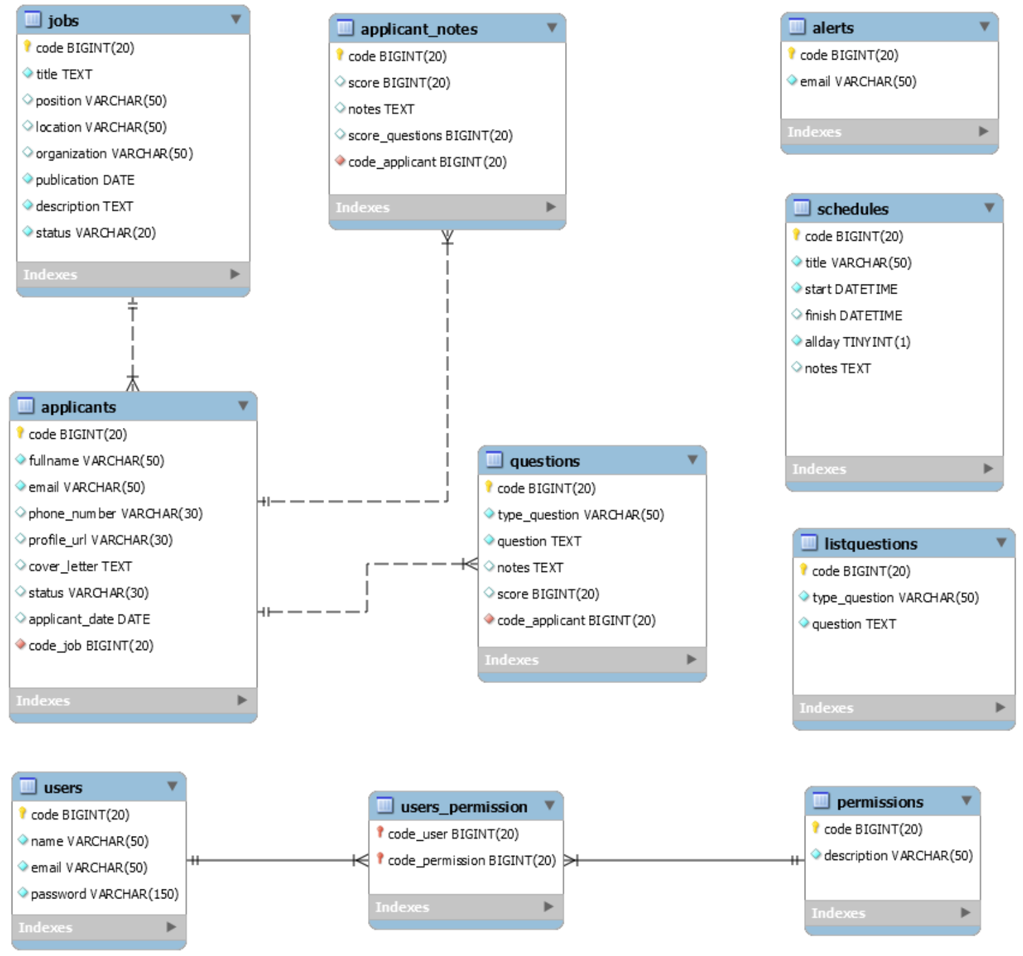
API
Spring boot
For the MyCareer project, the API will serve as the data for the UI, the persistence of the data and also to ensure the security of the application.
This is a RESTful API that uses the following technologies:
Spring Boot;
String Security;
JWT;
Hibernate;
API – Swagger UI
https://mycareer-api.herokuapp.com/swagger-ui.html
The best team is where
the best leader be

Slide 15
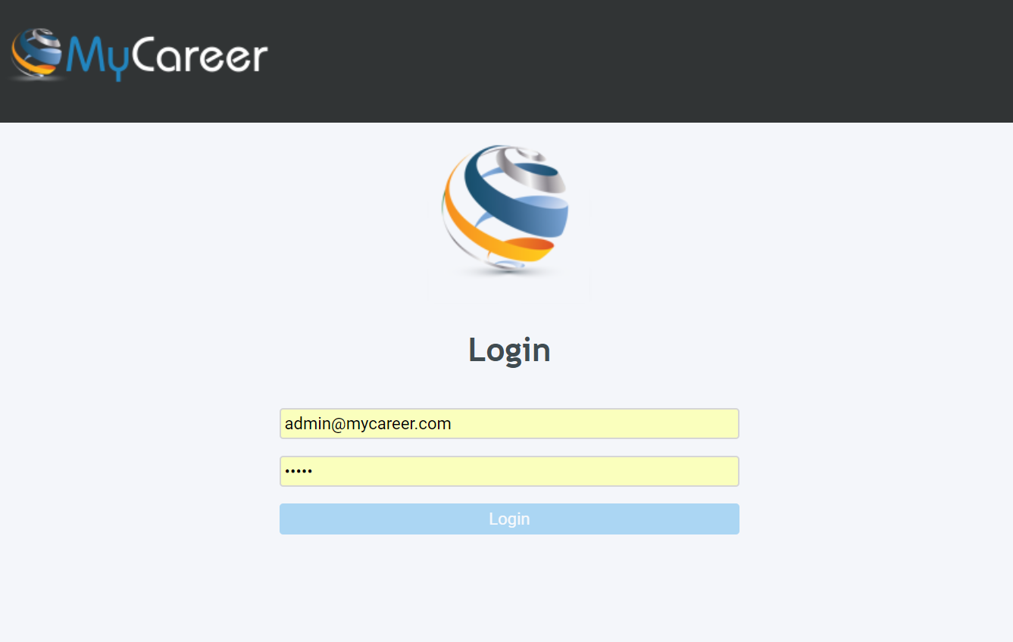
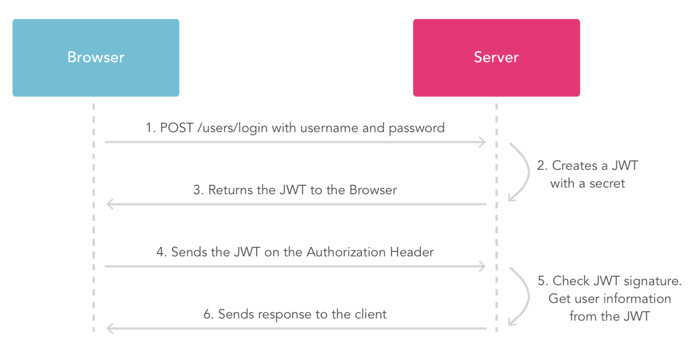
API - Security
Spring boot
The best team is where
the best leader be

Slide 16
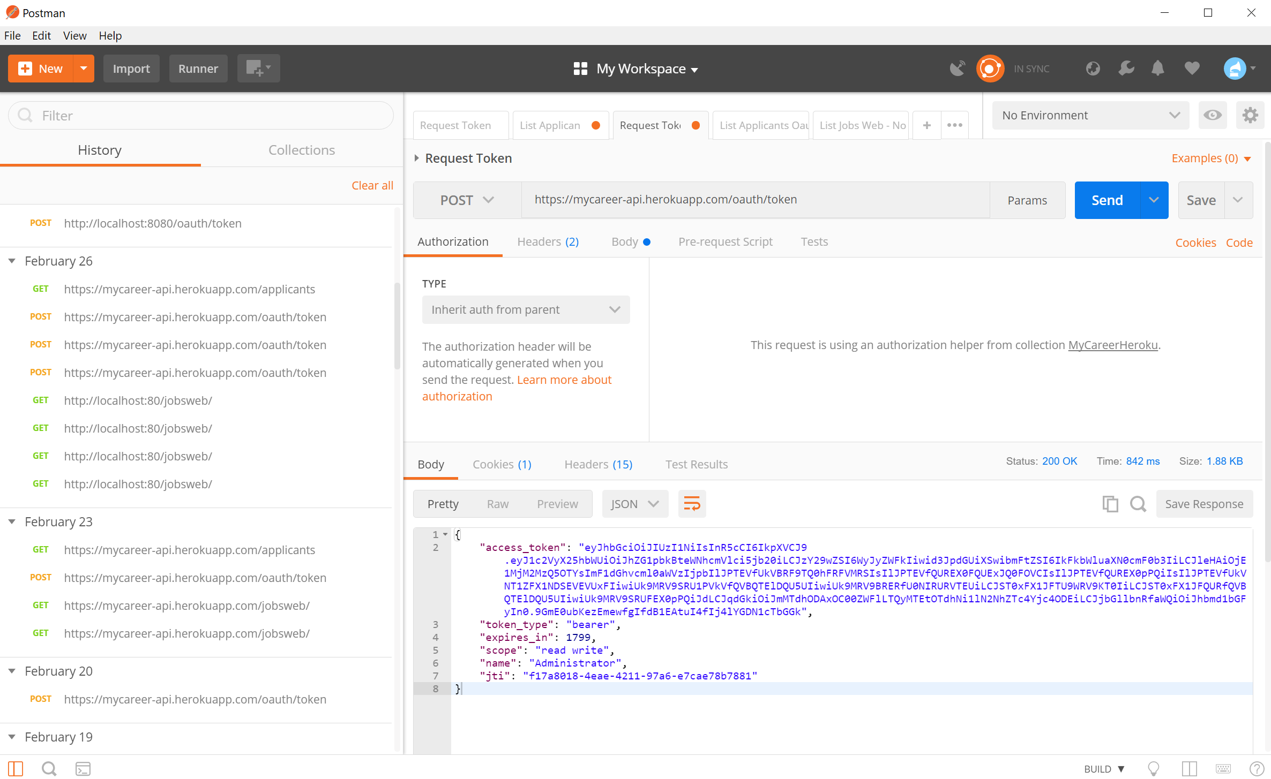
Testing the API
The best team is where
the best leader be

Slide 17
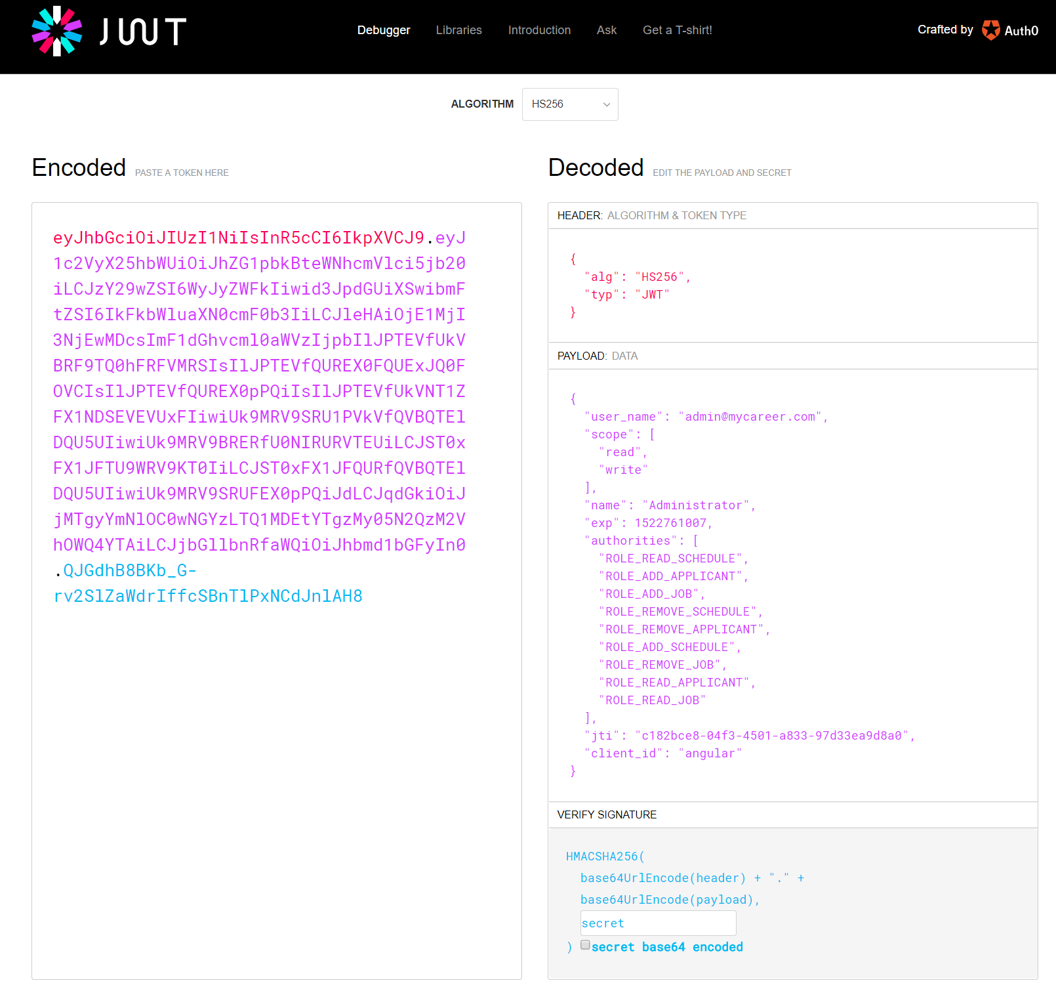
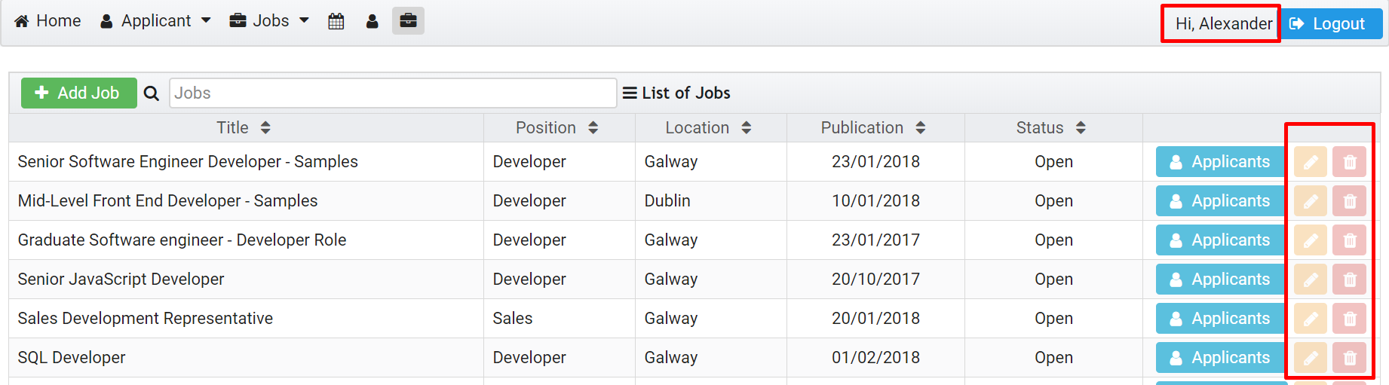
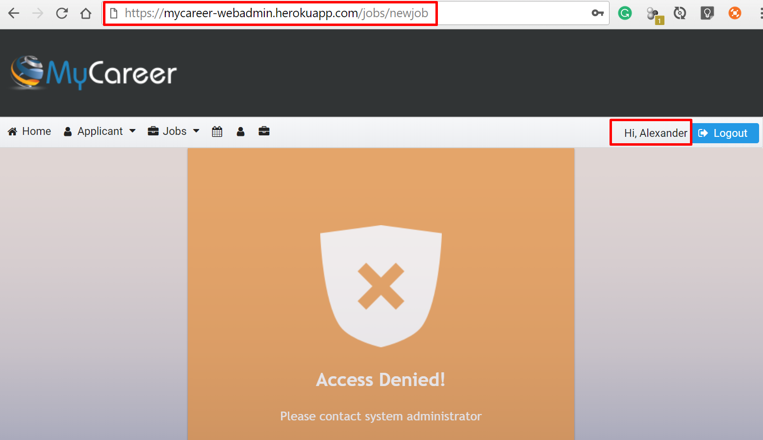
API - Security
Spring boot
These rules (Payload) will be used in the system in order to be able to enable or disable system functionalities, thus creating different levels of access.
The UI applies this rule over the buttons, which can disable or make them invisible.
The best team is where
the best leader be

Slide 18
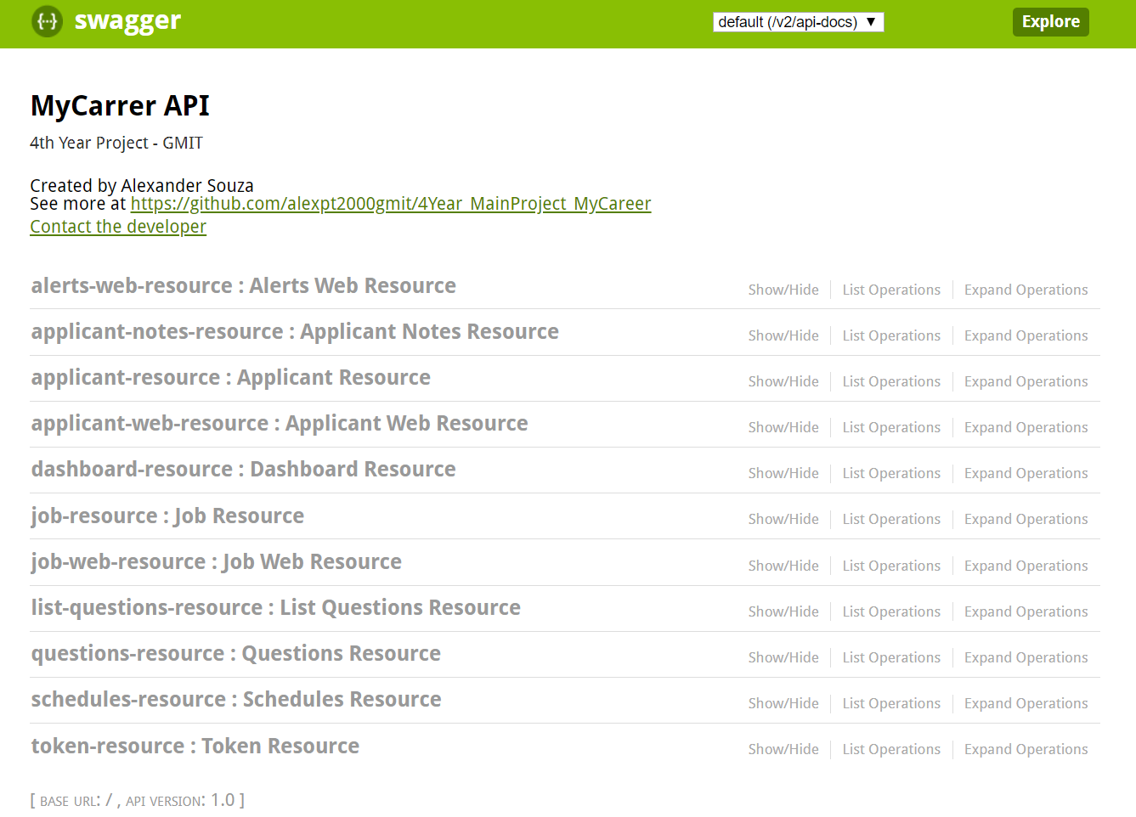
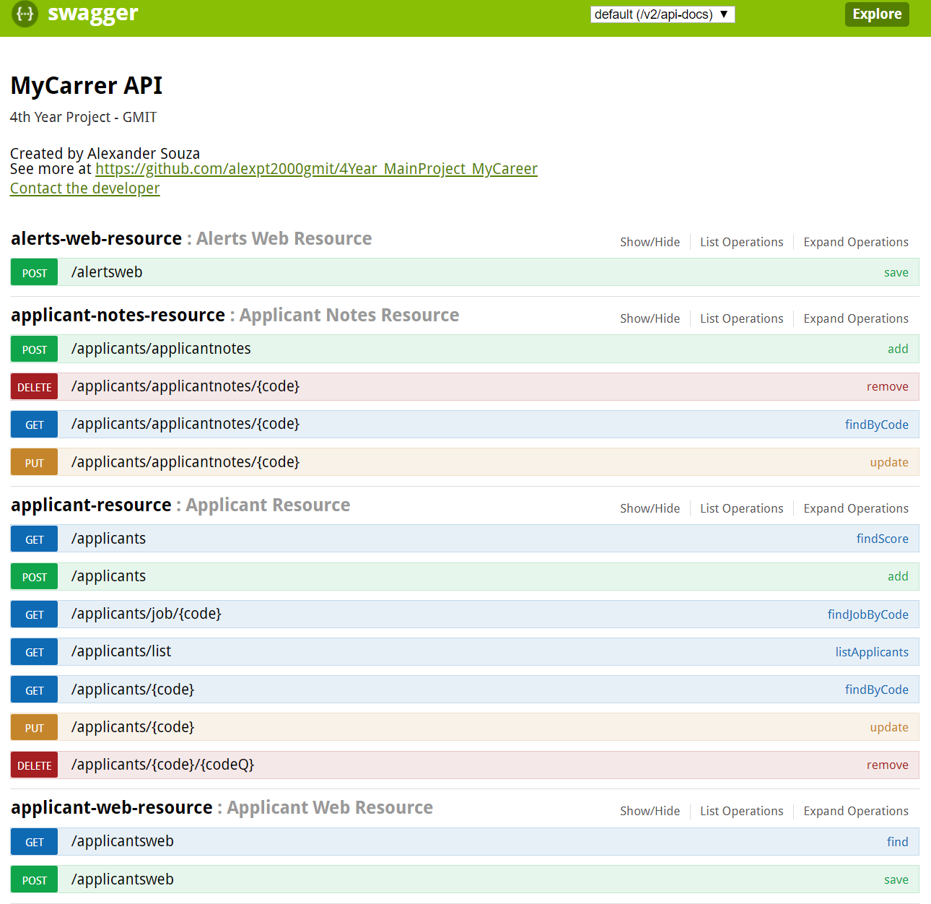
Testing the API
API – Swagger UI
https://mycareer-api.herokuapp.com/swagger-ui.html
The best team is where
the best leader be

Slide 19
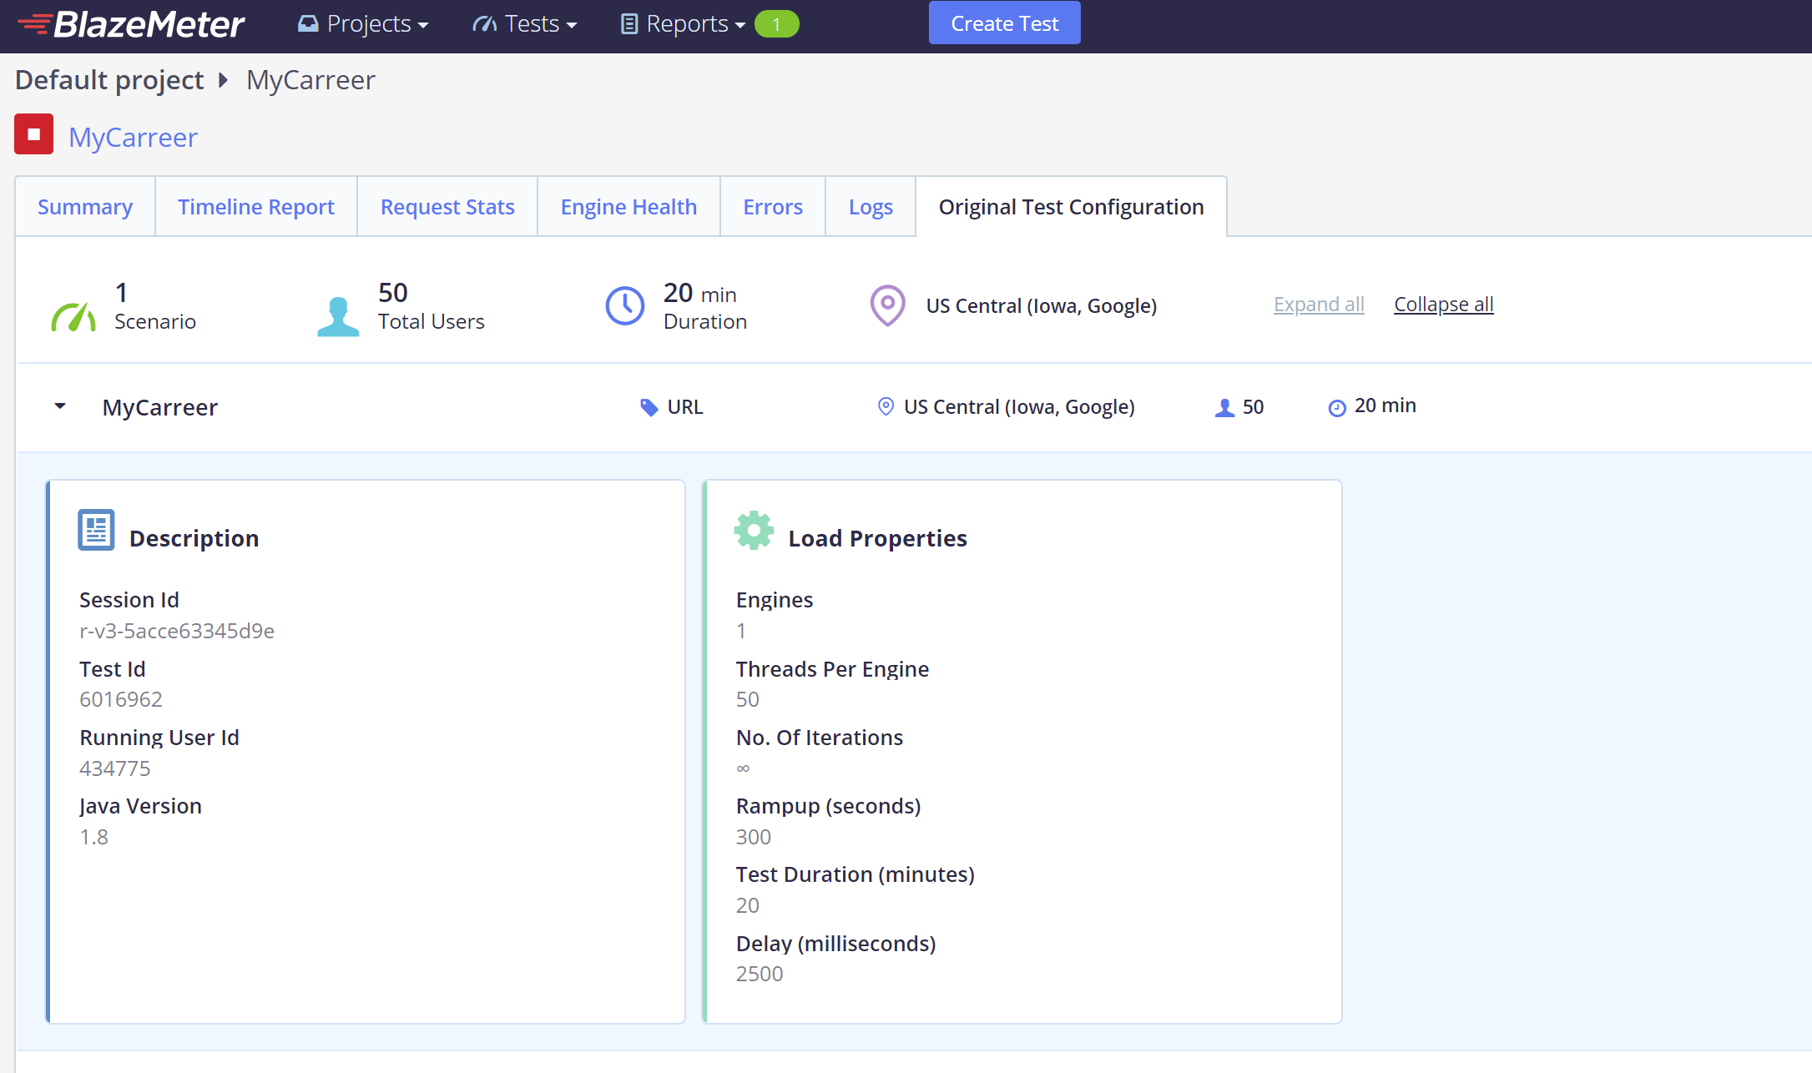
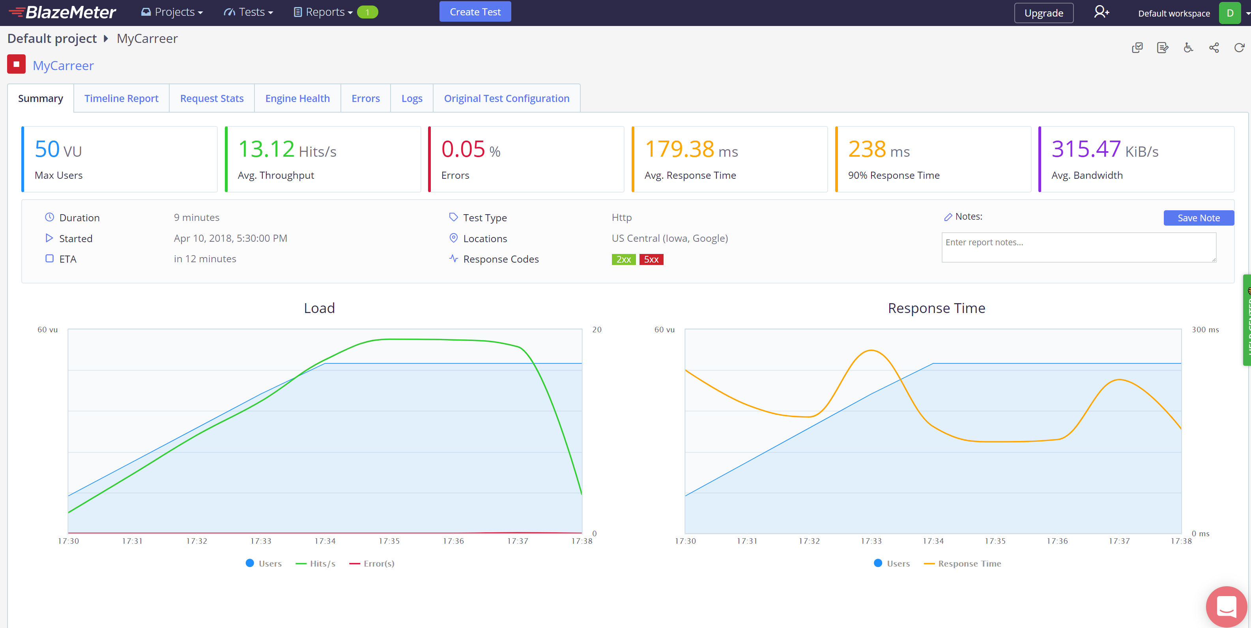
Testing the API
BlazeMeter
BlazeMeter provides developers with tools using the Amazon Elastic Compute Cloud (EC2) service that provides mobile, web application, website, web-service or database testing that can simulate thousands of users.
The best team is where
the best leader be

Slide 20
Thanks ☺

